Slide 1

Open gl
Presented by Matas kvainauskas

Slide 2


What is open gl?

Slide 3
Some history
Released in 1992 by Silicon Graphics Inc
Since 2006 managed by non-profit technology consortium Khronos Group.
Newest version is 4.6 (2017)

Slide 4
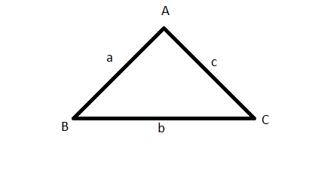
Triangles

Slide 5
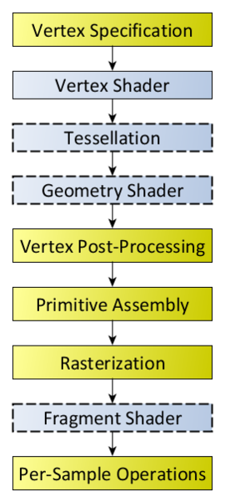
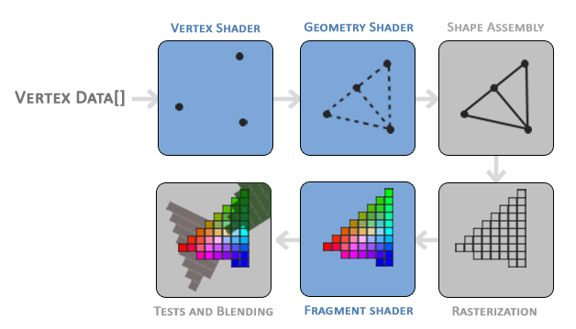
THe OPEN GL PIPELINE

Slide 6
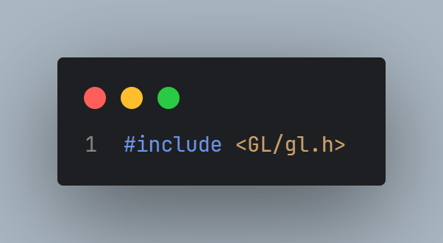
Code Example !

Slide 7
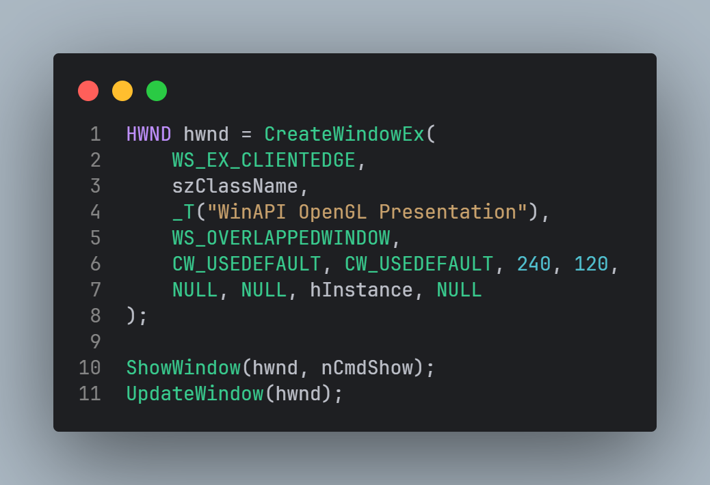
Create window

Slide 8
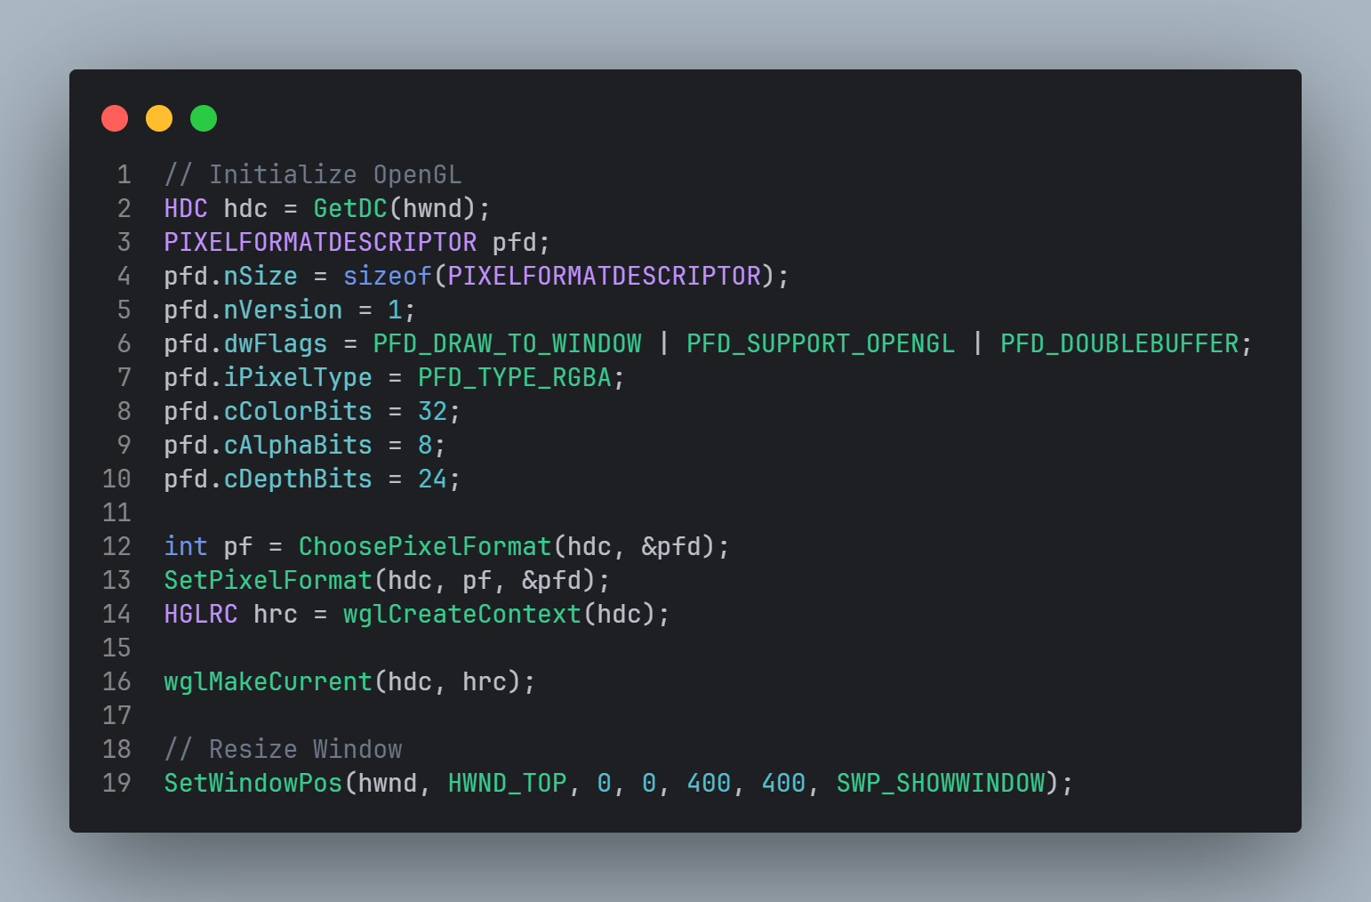
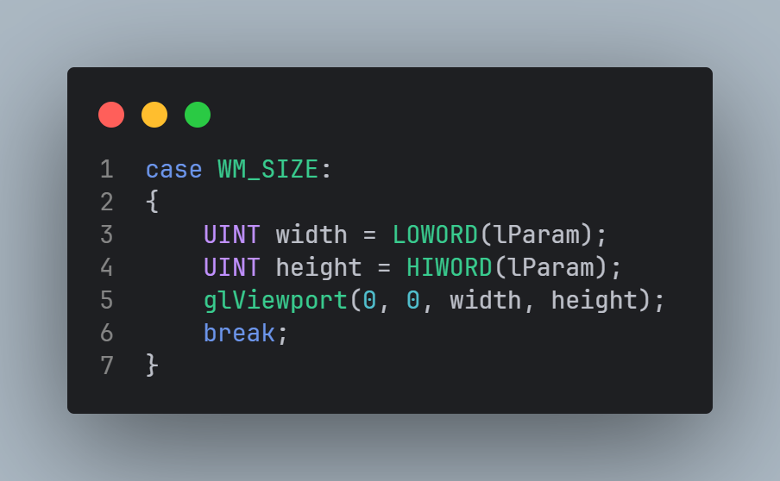
configure

Slide 9
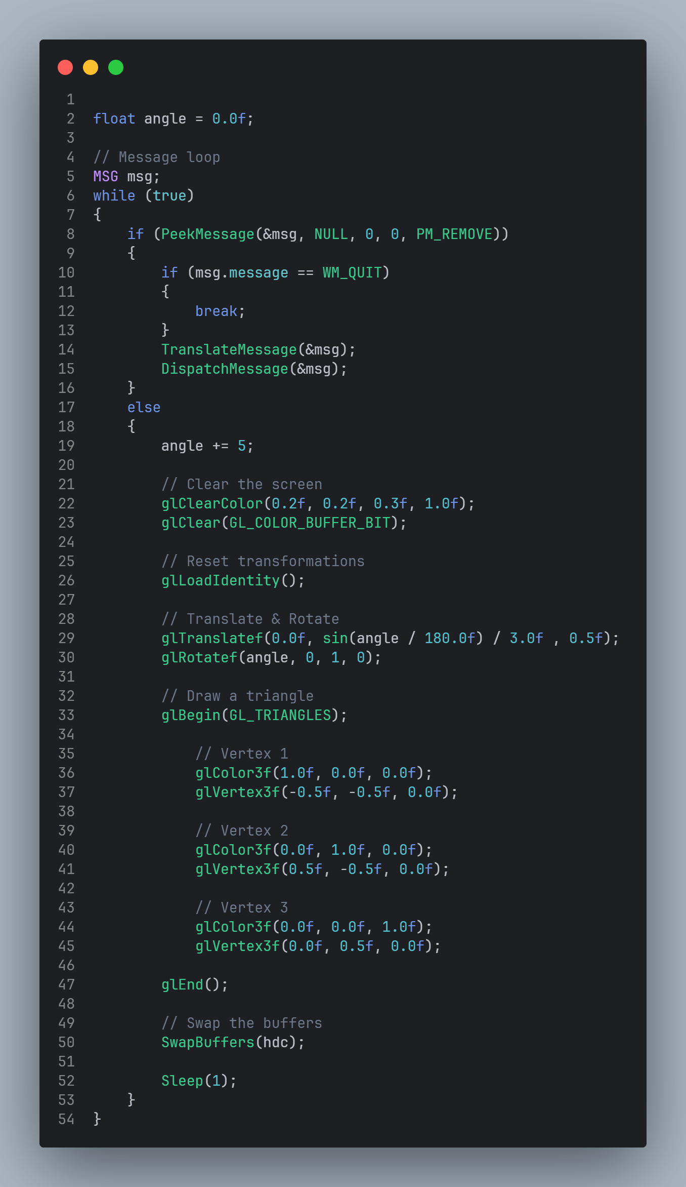
Rendering

Slide 10
COMPILATION
g++ -o main.exe .\main.cpp -lopengl32 -lgdi32

Slide 12
Getting started
https://www.khronos.org/opengl/wiki/Getting_Started
https://learn.microsoft.com/en-us/windows/win32/opengl/opengl

Slide 13





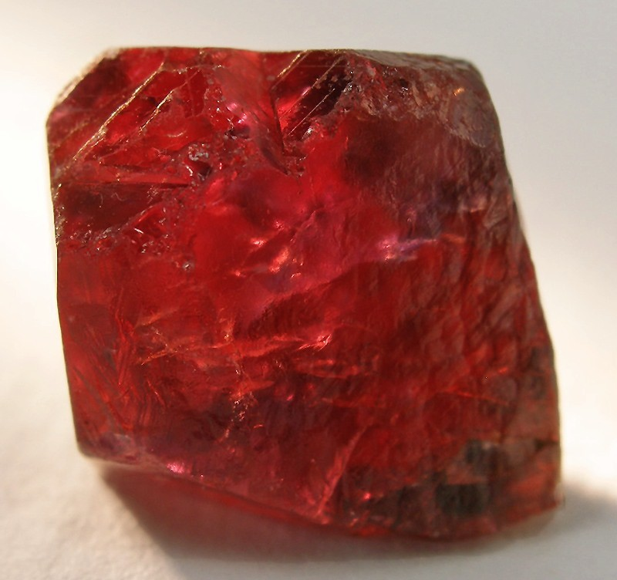
Open gl bindings for other languages

